Slide 1

Sparrow - A Virtual Assistance
Presented by
Bhargav Gondesi, Aarti Ravindra Gorle, Princy Sharma, Sonali Linsay Kathi

Slide 2
Introduction
The Virtual Assistance Is an Application Designed to assist With few Interesting features using voice recognition or text to speech technology.
It performs tasks like Setting up reminders, checking on the weather, alarms, timers and browsing web.
The assistant take the command and process them and Provide feedback.

Slide 3
Key Libraries
We used python programming language
Speech recognition - For voice input
Pyttsx3 – For text to speech functionality
Tkinter – For GUI interface
Pygame – For sound effects

Slide 4
System Architecture
The core components of this Project :
Speech Recognition module
Task Execution using threading
Text to speech converter
Graphical user interface(GUI)

Slide 5
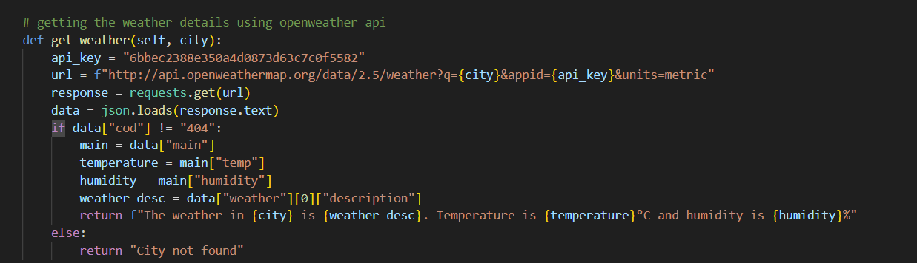
APIs used
The external API (open weathermap) acts as a source for weather data. The way it works is as we input the complier takes the city name and using the api it gathers the weather details and gives the output in the form of speech.

Slide 6
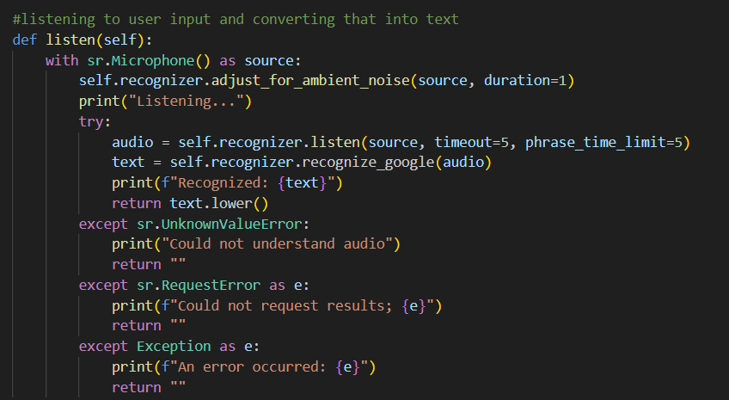
Speech Recognition Implementation
- Library: speech_recognition
- Features:
• Ambient noise adjustment
• Timeout and phrase time limit settings

Slide 7
Natural Language Understanding
Approach : Rule-based keyword extraction.
Process : Convert input to lowercase.
Check for specific keywords(e.g, “reminder”, “alarm”, “weather”).
Extract relevant information-based on command type.

Slide 8
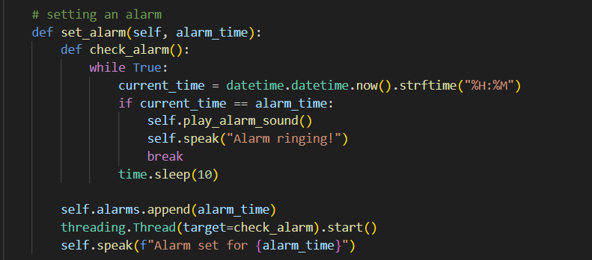
Task Execution
- Modular Design:
• Separate methods for each functionality (reminders, alarms, timers, weather, web search)
- Multi-threading:
• Uses Python's threading library for non-blocking operations.

Slide 9
Weather Information Retrieval
API: OpenWeatherMap
Process: 1. Construct API request URL with city name and API key
2. Send GET request using requests library
3. Parse JSON response
4. Extract relevant weather data (temperature, humidity, description)
Error Handling : Check for 404 response to handle invalid city names

Slide 10
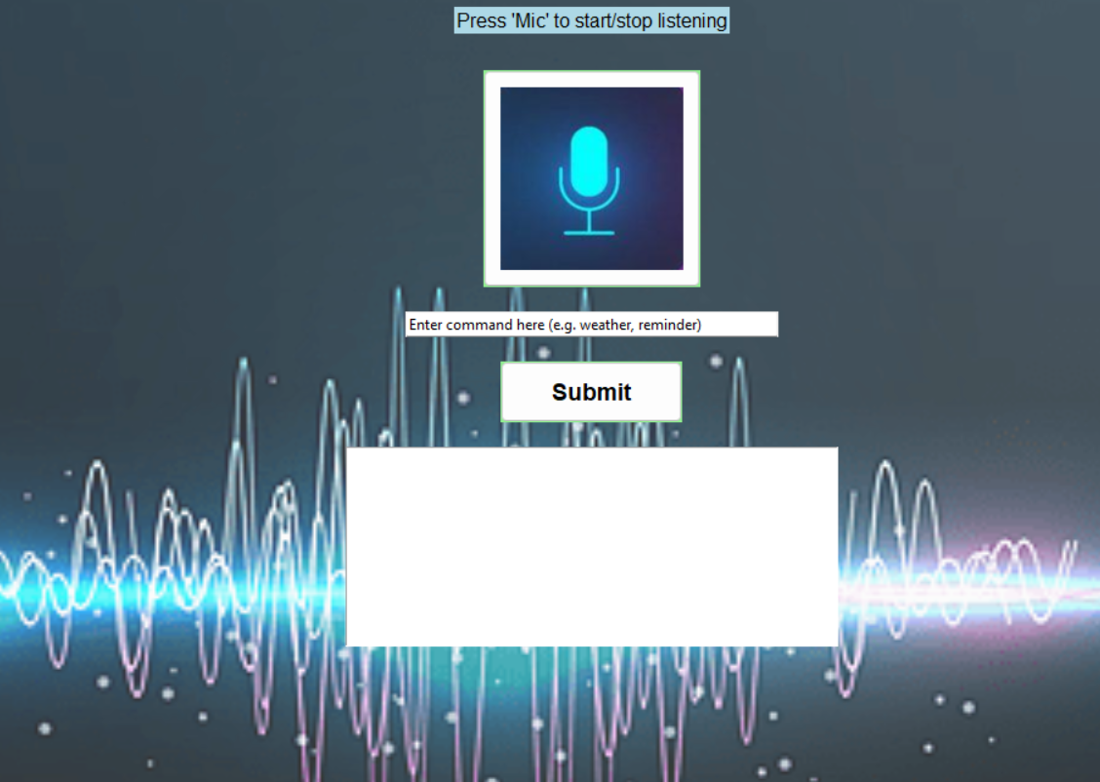
Graphical User Interface
Library: tkinter
Components:
1. Microphone button (with custom image)
2. Text input field
3. Submit button
4. Output text area
Event Handling:
• Button click events
• Text input submission

Slide 11
Challenges and Solutions
1. Continuous Listening: Implemented a toggle mechanism for start/stop listening
2. Concurrent Operations: Utilized threading for non-blocking task execution
3. Error Handling: Implemented try-except blocks for robust error management
4. Cross-platform Compatibility: Chose libraries with good cross-platform support

Slide 12
Future Work and conclusion
- Potential Enhancements:
Implement machine learning for improved NLU.
Expand functionality (e.g., calendar integration, smart home control).
Develop mobile application version.
Implement machine learning-based NLP for more complex understanding.
- Conclusions:
Successfully implemented a functional virtual assistant using Python.
Demonstrated integration of various technologies (speech recognition, NLP, APIs).
Identified areas for future improvement and research.

Slide 13
References
https://www.youtube.com/watch?v=ibf5cx221hk
https://www.youtube.com/watch?v=mYUyaKmvu6Y
https://www.youtube.com/watch?v=zxhMjpDOFPE
https://www.youtube.com/watch?v=1luwesQF5JM
GitHub repository link: https://github.com/RPrincy/Personal-Virtual-Assistant

Slide 14
Thank You

